Slide 1
Convolutional Neural Networks
Trong-Hop Do
Lecture 5 -
1

Slide 2

Last time: Neural Networks
Lecture 5 -
2

Slide 3
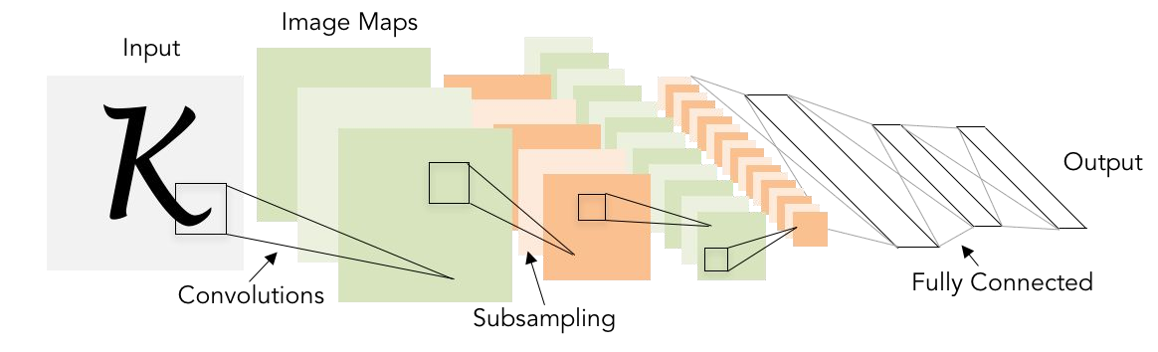
Next: Convolutional Neural Networks
Illustration of LeCun et al. 1998 from CS231n 2017 Lecture 1
Lecture 5 -
3

Slide 4


A bit of history:
Neocognitron
[Fukushima 1980]
“sandwich” architecture (SCSCSC…) simple cells: modifiable parameters complex cells: perform pooling
Lecture 5 -
1133

Slide 5

A bit of history:
Gradient-based learning applied to document recognition
[LeCun, Bottou, Bengio, Haffner 1998]
LeNet-5
Lecture 5 -
1144

Slide 6

A bit of history:
ImageNet Classification with Deep Convolutional Neural Networks [Krizhevsky, Sutskever, Hinton, 2012]
“AlexNet”
Lecture 5 -
1155

Slide 7
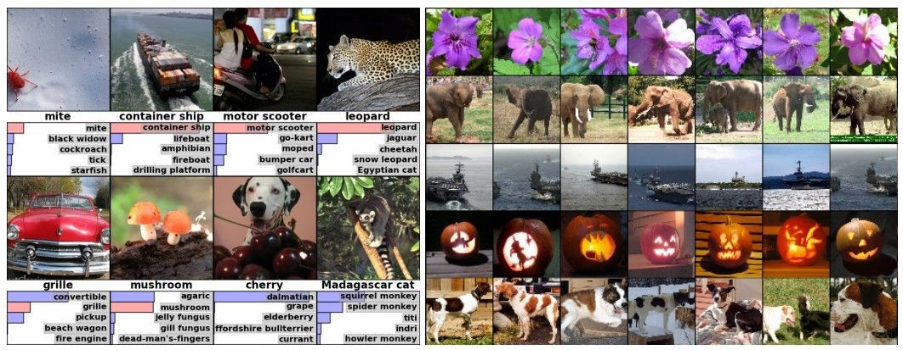
Fast-forward to today: ConvNets are everywhere
Classification Retrieval
Figures copyright Alex Krizhevsky, Ilya Sutskever, and Geoffrey Hinton, 2012. Reproduced with permission.

Slide 8
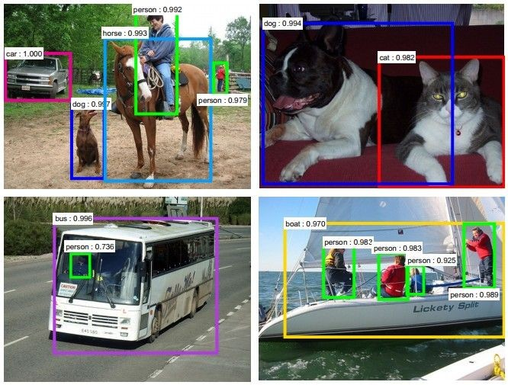
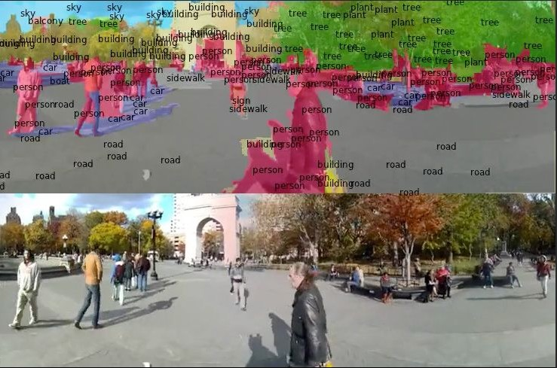
Fast-forward to today: ConvNets are everywhere
Detection Segmentation
Figures copyright Shaoqing Ren, Kaiming He, Ross Girschick, Jian Sun, 2015. Reproduced with permission.
[Faster R-CNN: Ren, He, Girshick, Sun 2015]
Figures copyright Clement Farabet, 2012. Reproduced with permission.
[Farabet et al., 2012]

Slide 9
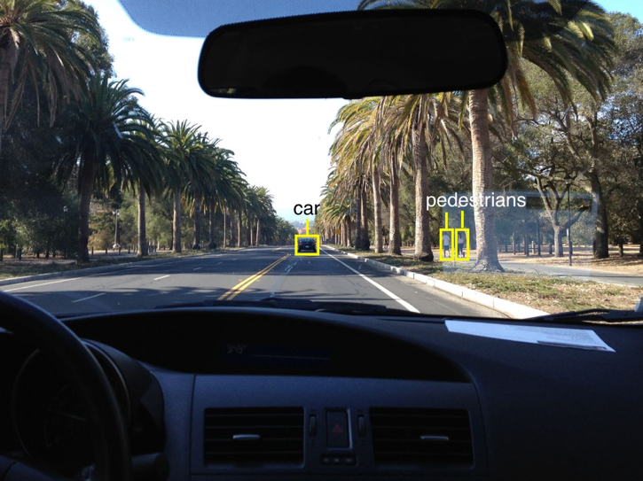
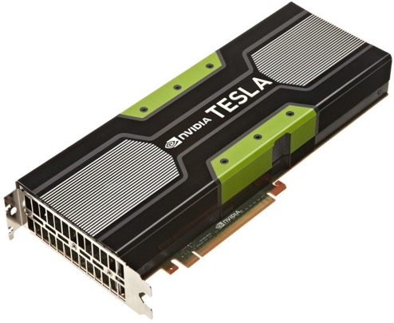
Fast-forward to today: ConvNets are everywhere
This image by GBPublic_PR is licensed under CC-BY 2.0
NVIDIA Tesla line
(these are the GPUs on rye01.stanford.edu)
Note that for embedded systems a typical setup would involve NVIDIA Tegras, with integrated GPU and ARM-based CPU cores.
self-driving cars
Photo by Lane McIntosh. Copyright CS231n 2017.

Slide 10
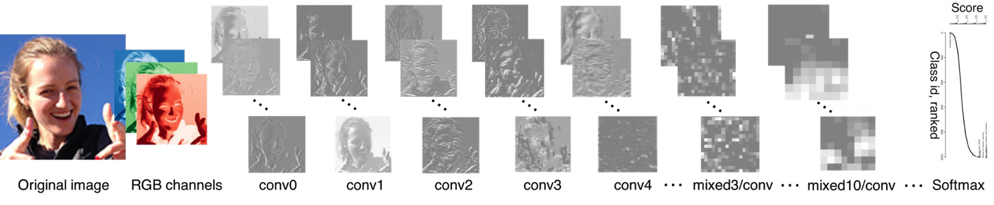
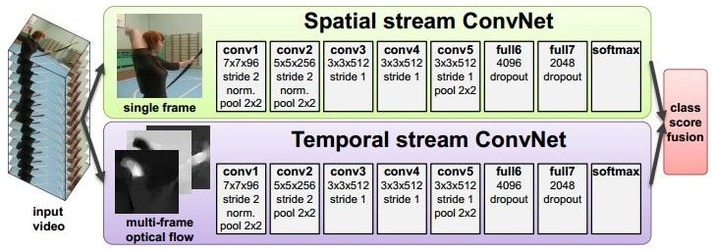
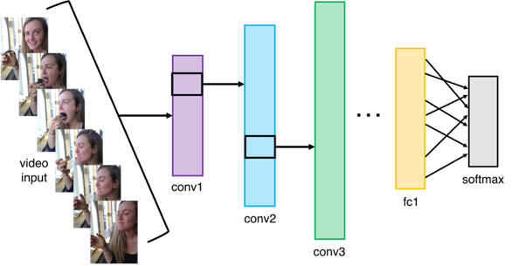
Fast-forward to today: ConvNets are everywhere
[Taigman et al. 2014]
Activations of inception-v3 architecture [Szegedy et al. 2015] to image of Emma McIntosh, used with permission. Figure and architecture not from Taigman et al. 2014.
Figures copyright Simonyan et al., 2014. Reproduced with permission.
Illustration by Lane McIntosh, photos of Katie Cumnock used with permission.
[Simonyan et al. 2014]

Slide 11
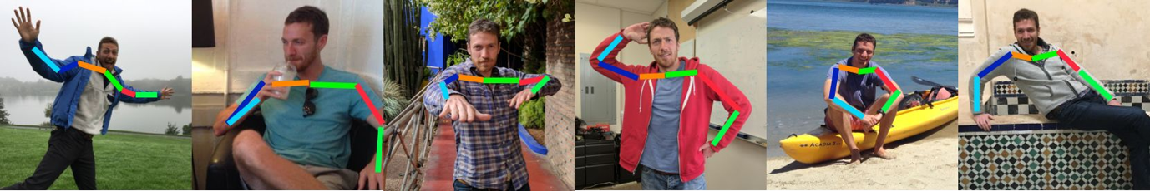
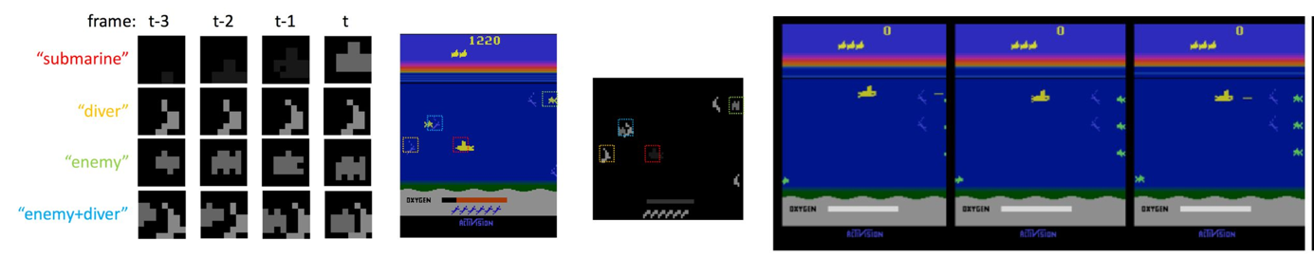
Fast-forward to today: ConvNets are everywhere
Images are examples of pose estimation, not actually from Toshev & Szegedy 2014. Copyright Lane McIntosh.
[Toshev, Szegedy 2014]
[Guo et al. 2014]
Figures copyright Xiaoxiao Guo, Satinder Singh, Honglak Lee, Richard Lewis, and Xiaoshi Wang, 2014. Reproduced with permission.

Slide 12
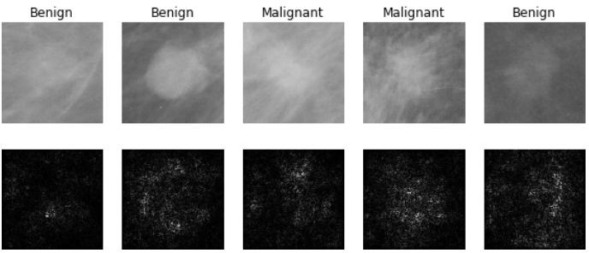
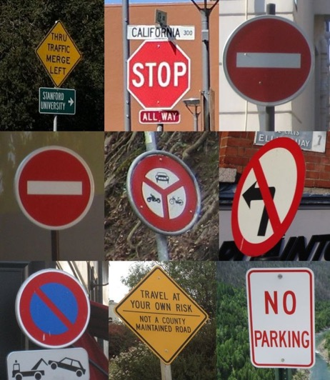
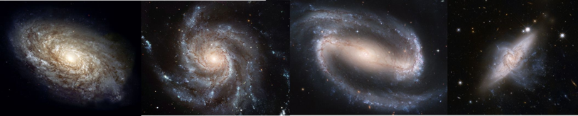
Fast-forward to today: ConvNets are everywhere
[Levy et al. 2016]
Figure copyright Levy et al. 2016. Reproduced with permission.
[Sermanet et al. 2011] [Ciresan et al.]
Photos by Lane McIntosh. Copyright CS231n 2017.
[Dieleman et al. 2014]
From left to right: public domain by NASA, usage permitted by ESA/Hubble, public domain by NASA, and public domain.

Slide 13
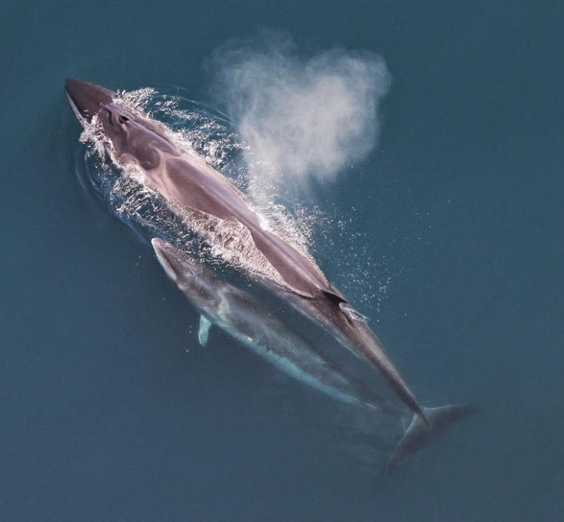
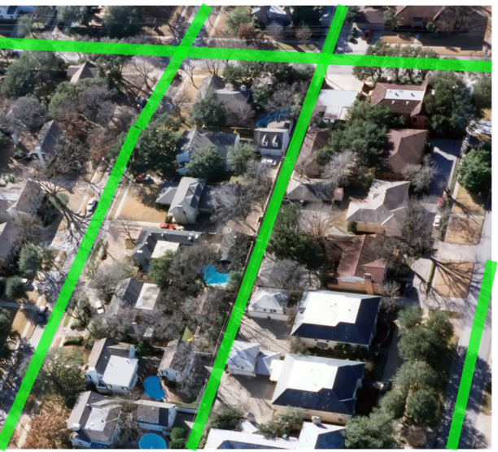
This image by Christin Khan is in the public domain and originally came from the U.S. NOAA.
Photo and figure by Lane McIntosh; not actual example from Mnih and Hinton, 2010 paper.
Whale recognition, Kaggle Challenge
Mnih and Hinton, 2010

Slide 14
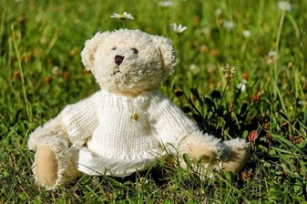
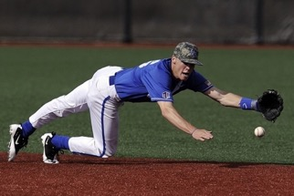
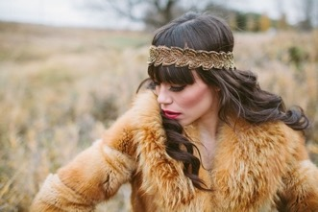
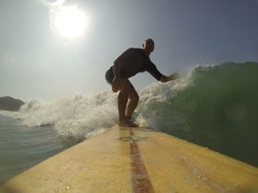

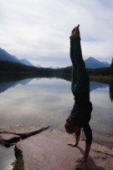
No errors
Minor errors
Somewhat related
Image Captioning
[Vinyals et al., 2015] [Karpathy and Fei-Fei, 2015]
A white teddy bear sitting in the grass
A man in a baseball uniform throwing a ball
A woman is holding a cat in her hand
All images are CC0 Public domain: https://pixabay.com/en/luggage-antique-cat-1643010/
https://pixabay.com/en/teddy-plush-bears-cute-teddy-bear-1623436/ https://pixabay.com/en/surf-wave-summer-sport-litoral-1668716/ https://pixabay.com/en/woman-female-model-portrait-adult-983967/ https://pixabay.com/en/handstand-lake-meditation-496008/ https://pixabay.com/en/baseball-player-shortstop-infield-1045263/
A man riding a wave on top of a surfboard
A cat sitting on a suitcase on the floor
A woman standing on a beach holding a surfboard
Captions generated by Justin Johnson using Neuraltalk2

Slide 15
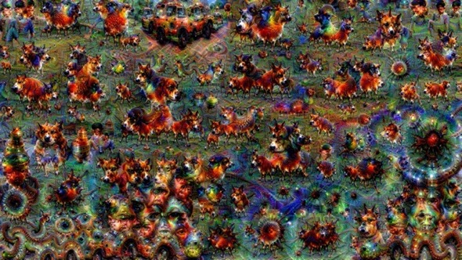
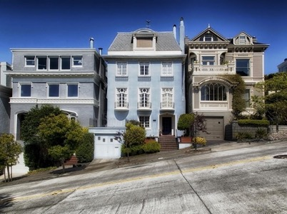
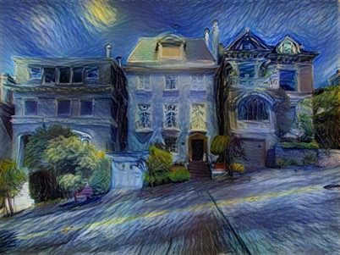

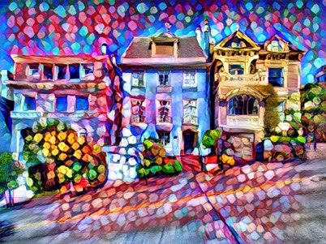
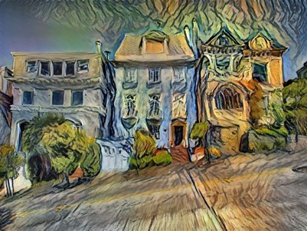
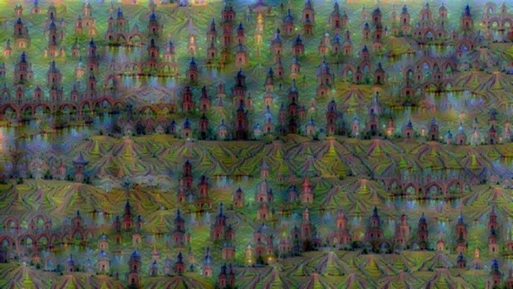

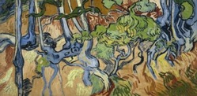
Original image is CC0 public domain
Starry Night and Tree Roots by Van Gogh are in the public domain Bokeh image is in the public domain
Stylized images copyright Justin Johnson, 2017; reproduced with permission
Gatys et al, “Image Style Transfer using Convolutional Neural Networks”, CVPR 2016 Gatys et al, “Controlling Perceptual Factors in Neural Style Transfer”, CVPR 2017
Figures copyright Justin Johnson, 2015. Reproduced with permission. Generated using the Inceptionism approach from a blog post by Google Research.

Slide 16
Convolutional Neural Networks
Fei-Fei Li & Justin Johnson & Serena Yeung April 18, 2017Lecture 5 -

Slide 17
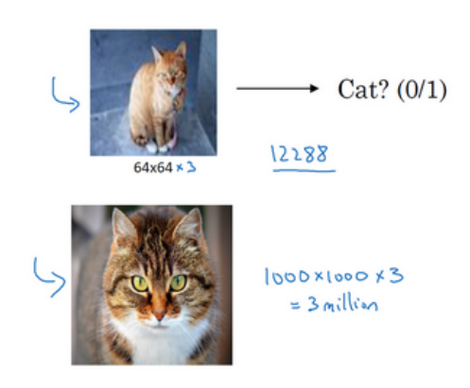
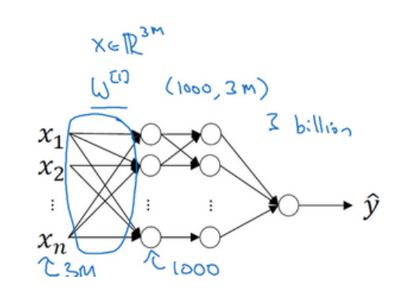
Fully Connected Layer

Slide 18
Fully Connected Layer
Two problems of NN:
Complex structure, and the amount of data is relatively insufficient, thus prone to overfitting.
Large amount of memory and calculation.
The solution to this problem is to use convolutional neural networks (CNN).

Slide 19
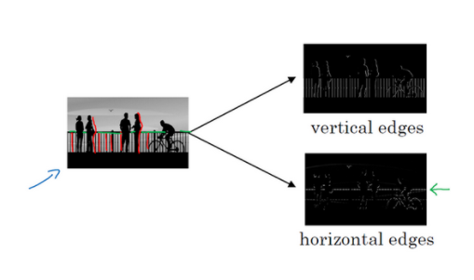
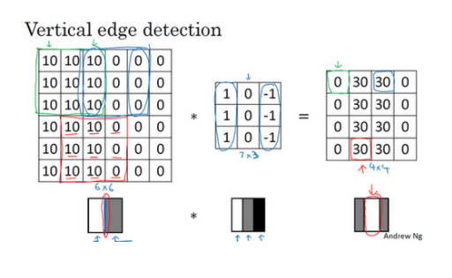
Edge detection example

Slide 20
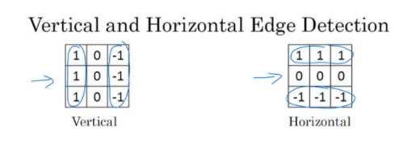
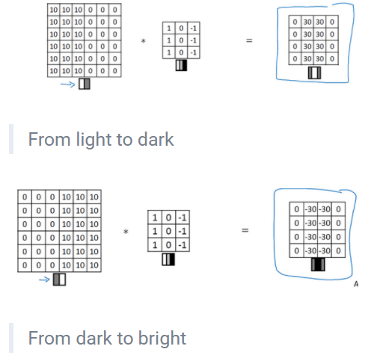
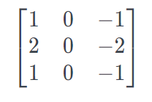
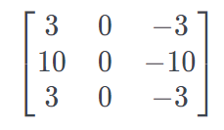
Edge detection example
Sobel filter Scharr filter

Slide 21
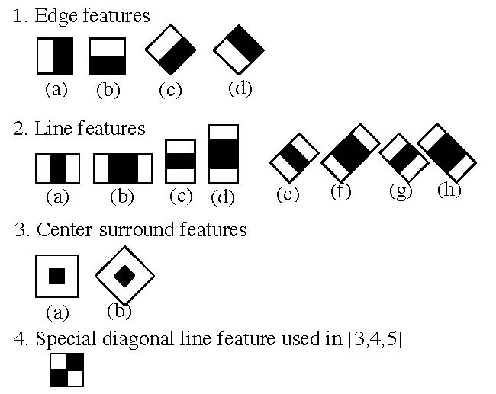
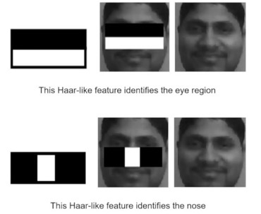
Haar like feature

Slide 22
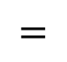

Convolution operation on image
Gray scale image
3 | 0 | 1 | 2 | 7 | 4
1 | 5 | 8 | 9 | 3 | 1
2 | 7 | 2 | 5 | 1 | 3
0 | 1 | 3 | 1 | 7 | 8
4 | 2 | 1 | 6 | 2 | 8
2 | 4 | 5 | 2 | 3 | 9
Output
Filter
1 | 0 | -1
1 | 0 | -1
1 | 0 | -1
$$⋆$$
$$=$$
6x6
3x3
4x4

Slide 23
Gray scale image
3 | 0 | 1 | 2 | 7 | 4
1 | 5 | 8 | 9 | 3 | 1
2 | 7 | 2 | 5 | 1 | 3
0 | 1 | 3 | 1 | 7 | 8
4 | 2 | 1 | 6 | 2 | 8
2 | 4 | 5 | 2 | 3 | 9
Output
Filter
-5
1 | 0 | -1
1 | 0 | -1
1 | 0 | -1
$$⋆$$
$$=$$
3x3
4x4
6x6

Slide 24
Gray scale image
3 | 0 | 1 | 2 | 7 | 4
1 | 5 | 8 | 9 | 3 | 1
2 | 7 | 2 | 5 | 1 | 3
0 | 1 | 3 | 1 | 7 | 8
4 | 2 | 1 | 6 | 2 | 8
2 | 4 | 5 | 2 | 3 | 9
Output
Filter
-5 | -4
1 | 0 | -1
1 | 0 | -1
1 | 0 | -1
$$⋆$$
$$=$$
3x3
4x4
6x6

Slide 25
Gray scale image
3 | 0 | 1 | 2 | 7 | 4
1 | 5 | 8 | 9 | 3 | 1
2 | 7 | 2 | 5 | 1 | 3
0 | 1 | 3 | 1 | 7 | 8
4 | 2 | 1 | 6 | 2 | 8
2 | 4 | 5 | 2 | 3 | 9
Output
Filter
-5 | -4 | 0 | 8
-10 | -2 | 2 | 3
0 | -2 | -4 | -7
-3 | -2 | -3 | -16
1 | 0 | -1
1 | 0 | -1
1 | 0 | -1
$$⋆$$
$$=$$
3x3
4x4
6x6

Slide 26
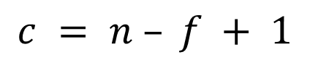

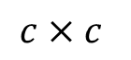
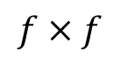
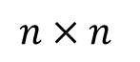
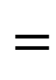
Padding
$$⋆$$
$$=$$
$$f×f$$
$$c×c$$
$$n×n$$
$$c = n – f + 1$$
Two main downsides
Shrinking outputs
Loosing information on corners of the image

Slide 27
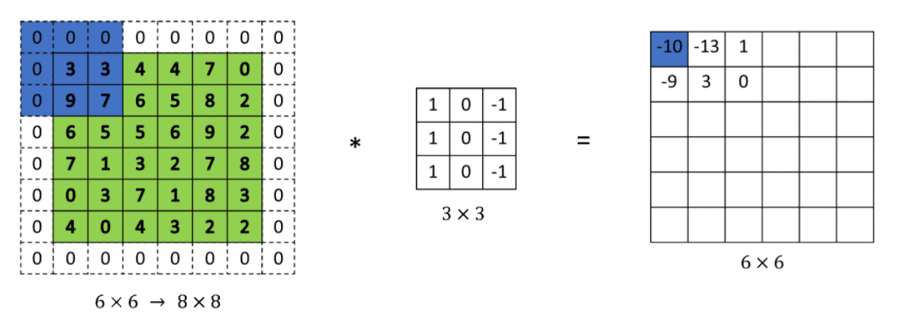
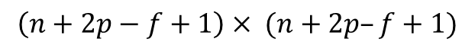
Padding
Apply padding$p=1$
$$\left(n+2p−f+1\right)× (n+2p–f+1)$$

Slide 28
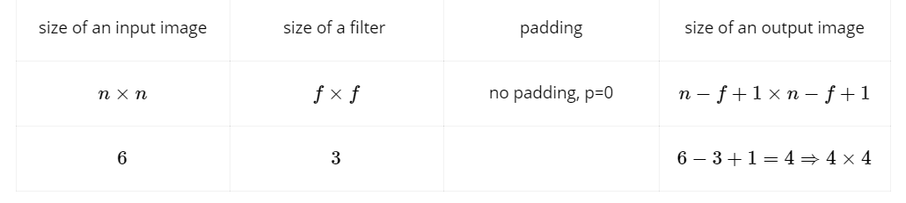
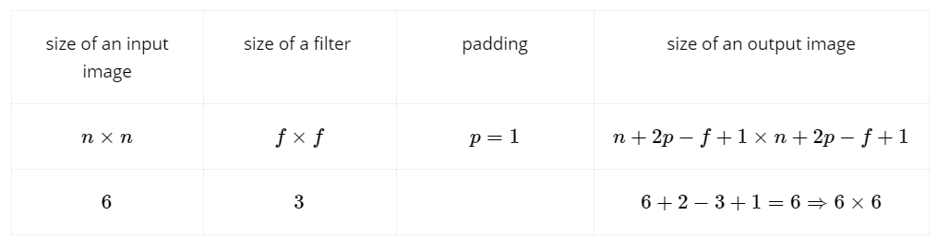
Valid and same convolutions
Valid convolutions = no padding
Same convolution = pad so that output size is the same as input size

Slide 29
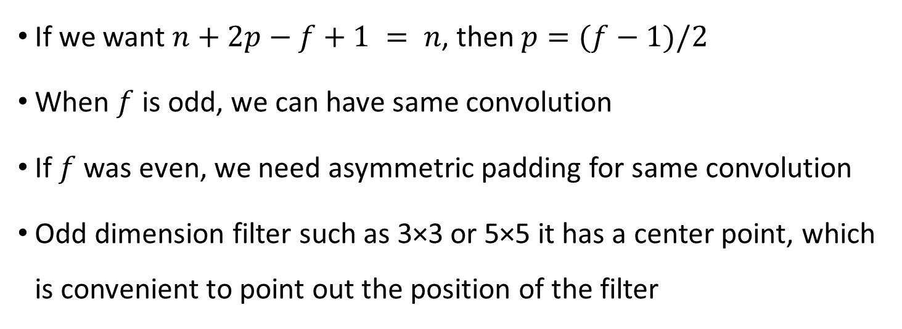
Why odd pading
If we want $n+2p−f+1 = n$, then $p=(f−1)/2$
When $f$ is odd, we can have same convolution
If $f$was even, we need asymmetric padding for same convolution
Odd dimension filter such as 3×3 or 5×5 it has a center point, which is convenient to point out the position of the filter

Slide 30
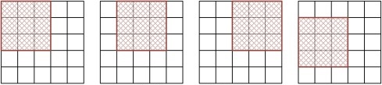



Strided Convolution
$$s=1$$
$s=$2
Stride represents the length of each step of the filter in the horizontal and vertical directions in the original image. The default stride=1 before. If stride=2, it means that the length of each step of the filter is 2, that is, move once every other point

Slide 31
2 | 3 | 7 | 4 | 6 | 2 | 9
6 | 6 | 9 | 8 | 7 | 4 | 3
3 | 4 | 8 | 3 | 8 | 9 | 7
7 | 8 | 3 | 6 | 6 | 3 | 4
4 | 2 | 1 | 8 | 3 | 4 | 6
3 | 2 | 4 | 1 | 9 | 8 | 3
0 | 1 | 3 | 9 | 2 | 1 | 4
91
3 | 4 | 4
1 | 0 | 2
-1 | 0 | 3
$$⋆$$
$$=$$
3x3
3x3
7x7

Slide 32
2 | 3 | 7 | 4 | 6 | 2 | 9
6 | 6 | 9 | 8 | 7 | 4 | 3
3 | 4 | 8 | 3 | 8 | 9 | 7
7 | 8 | 3 | 6 | 6 | 3 | 4
4 | 2 | 1 | 8 | 3 | 4 | 6
3 | 2 | 4 | 1 | 9 | 8 | 3
0 | 1 | 3 | 9 | 2 | 1 | 4
91 | 100
3 | 4 | 4
1 | 0 | 2
-1 | 0 | 3
$$⋆$$
$$=$$
3x3
3x3
7x7

Slide 33
2 | 3 | 7 | 4 | 6 | 2 | 9
6 | 6 | 9 | 8 | 7 | 4 | 3
3 | 4 | 8 | 3 | 8 | 9 | 7
7 | 8 | 3 | 6 | 6 | 3 | 4
4 | 2 | 1 | 8 | 3 | 4 | 6
3 | 2 | 4 | 1 | 9 | 8 | 3
0 | 1 | 3 | 9 | 2 | 1 | 4
91 | 100 | 88
69 | 91 | 117
44 | 72 | 74
3 | 4 | 4
1 | 0 | 2
-1 | 0 | 3
$$⋆$$
$$=$$
3x3
3x3
7x7

Slide 34

Strided convolution

Slide 35

Convolution On RGB Images

Slide 36

Convolution On RGB Images

Slide 37

Convolution On RGB Images

Slide 38

Multiple filters
The number of output channels equal to the number of features we are trying to detect.

Slide 39

One layer of a Convolutional Neural Network

Slide 40


One layer of a Convolutional Neural Network
In neural networks: $Z^{[1]}=W^{\left[1\right]}×a^{\left[0\right]}+b^{\left[1\right]}$, where $a^{\left[0\right]}=x$. Then $a^{\left[1\right]}=g\left(Z^{\left[1\right]}\right)$.
The same idea is applied for a layer of CNN. The convolution operation corresponds to the product operation, and the filter corresponds to the weight $W^{[1]}$.

Slide 41

Number of parameters in one layer
If you have 10 filters that are 3×3×3 in one layer of neural network, how many parameters does that layer have?
No matter how big the input images are the number of parameters will remain fixed

Slide 42









Dimension of layers and parameters
Input:
Each filter:
Weight:
Bias:
Output:
Let the number of layers be $l$
Each filter: $3×3×3$
Weight: $3×3×3×10$
Bias: $10$

Slide 43

An Example of A Convolutional Neural Network

Slide 44
There are three types of layers in a convolutional network:
Convolution(conv)
Pooling(pool)
Fullyconnected(FC)

Slide 45
Pooling layers
Apart from convolutional layers, CNN often use pooling layers to reduce the image size.
Hence, this layer speeds up the computation and this also makes some of the features they detect a bit more robust.
There are two types of pooling:
Maxpooling
Averagepooling
Pooling layers do not have parameter. However, they have hyperparameters.

Slide 46


Max pooling
Output:

Slide 47



Max pooling
Output:

Slide 48


Max pooling on multiple channels
The Max pooling calculation is performed on each channel independently.
If we have $5×5×nc$, the output would be $3×3×nc$. The Max pooling computation is done independently on each of these nc channels.

Slide 49

Average pooling
Output:

Slide 50


Convolutional Neural Network – An Example

Slide 51

Convolutional Neural Network – An Example

Slide 52

Convolutional Neural Network – An Example

Slide 53

Convolutional Neural Network – An Example
LeNet−5

Slide 54
Why convolutions?
Two main advantages of Convolutional layers over Fullyconnected layers:
parameter sharing and
sparsity of connections.

Slide 55

Why convolutions?

Slide 56

Why convolutions?
Parameter sharing: A feature detector, such as a vertical edge detector, that’s useful in one part of the image may be useful in another part of the image as well

Slide 57

Why convolutions?
Sparsity of connections: In each layer, each output value depends only on a small number of inputs

Slide 58

Why convolutions?
Translation invariance: convolutional neural networks are being very good at capturing translation invariance, and that means that a picture of a cat shifted a couple pixels to the right is still a cat (same output).

Slide 59



Putting it all together: Training a CNN
We use a gradient descent to minimize the cost function J

Slide 60








Convolutions and Backpropagations
$$X∗F$$
$$O+b$$
$$ReLU(Z)$$
$$X$$
$$O$$
$$Z$$
$$A$$
…
$$L$$

Slide 61













Convolutions and Backpropagations
$$X∗F$$
$$O+b$$
$$ReLU(Z)$$
$$X$$
$$O$$
$$Z$$
$$A$$
…
$$L$$
$$dA=\frac{∂L}{∂A}$$
$$dZ=\frac{∂L}{∂Z}=\frac{∂L}{∂A}×\frac{∂A}{∂Z}$$
$$\frac{∂A}{∂Z}=\left\{\begin{aligned}0 if Z<0 \\ 1 if Z≥0\end{aligned}\right.$$
$$dO=\frac{∂L}{∂O}=dZ$$
ReLU
$$dO=\left\{\begin{aligned}0 if Z<0 \\ 1 if Z≥0\end{aligned}\right.$$
Hence,

Slide 62

Convolutions and Backpropagations

Slide 63


Convolutions and Backpropagations

Slide 64


Convolutions and Backpropagations

Slide 65


Convolutions and Backpropagations
Finding $∂L$/ $∂F$

Slide 66



Convolutions and Backpropagations
Finding $∂O$/ $∂F$

Slide 67




Convolutions and Backpropagations
Finding $∂L$/ $∂F$

Slide 68



Convolutions and Backpropagations
Finding $∂L$/ $∂F$

Slide 69


Convolutions and Backpropagations
Finding $∂L$/ $∂X$

Slide 70


Convolutions and Backpropagations
Finding $∂L$/ $∂O$

Slide 71


Convolutions and Backpropagations
Finding $∂L$/ $∂X$

Slide 72

Convolutions and Backpropagations
Finding $∂L$/ $∂X$

Slide 73

Convolutions and Backpropagations

Slide 74

Classic network: LeNet−5 (1998)
The goal of LeNet−5 was to recognize handwritten digits. So, it takes as an input 32×32×1 image. It is a grayscale image, thus the number of channels is 1.
Number of parameters – 60.000 (today we use networks with 10 million to a 100 million parameters)

Slide 75

Classic network: AlexNet (2012)

Slide 76

Classic network: AlexNet (2012)

Slide 77

Classic network: VGG 16 and VGG 19 (2014)

Slide 78

Classic network: VGG 16 and VGG 19 (2014)

Slide 79


The two problems of deep neural network
Vanishing gradient
Degradation

Slide 80




Vanishing gradient in CNN?
$$dO=\left\{\begin{aligned}0 if Z<0 \\ 1 if Z≥0\end{aligned}\right.$$

Slide 81


Degradation with deeper layers

Slide 82



Degradation with deeper layers
Original
Identical image

Slide 83

Residual networks (Resnets 2015)

Slide 84


Slide 85

Residual networks (Resnets)
Resnets are built out of a residual block.
It consists of two layers of a neural network where we start off with some activation a[l], then we are passing it through a residual block and we will finally get a[l+2].

Slide 86


Residual networks (Resnets)
Resnets are built out of a residual block.

Slide 87

Residual networks (Resnets)

Slide 88
Why ResNets work?
Original
Identical image

Slide 89


Why ResNets work?

Slide 90

Why ResNets work?

Slide 91


Residual bock with different input and output dimension
Same dimension
Different dimension
$$a^{[l+2]}=g\left(z^{[l+2]}+W_{s}∗a^{[l]}\right)$$

Slide 92


Residual bock with different input and output dimension
ResNets Identity block
ResNets convolutional block

Slide 93

Network in Network – 1×1 Convolutions

Slide 94

Network in Network – 1×1 Convolutions

Slide 95

Network in Network – 1×1 Convolutions

Slide 96

Inception Network (2014)

Slide 97

Inception Network
Motivation for the Inceptionnetwork

Slide 98


Inception Network
The problem of the computational cost

Slide 99

Inception Network
Using 1x2 convolution to reduce computational cost

Slide 100

Inception Network
An example of an Inception module

Slide 101

Inception Network

Slide 102




Transfer Learning
Dog
Pig
Neither
Dog
Pig
Neither

Slide 103

Transfer Learning
Trained network with 1000 classes output.

Slide 104


Transfer Learning

Slide 105
Transfer Learning

Slide 106


Transfer Learning

Slide 107

Transfer Learning

Slide 108

Transfer Learning

Slide 109

Data augmentation methods in computer vision

Slide 110

Data augmentation methods in computer vision

Slide 111

Data augmentation methods in computer vision

Slide 112

Data augmentation methods in computer vision

Slide 113
CNN for Computer Vision

Slide 114


So far: Image Classification
Class Scores
Cat: 0.9
Dog: 0.05
Car: 0.01
...
Fully-Connected: 4096 to 1000
Vector:
4096
This image is CC0 public domain
May 10, 2017

Slide 115




Other Computer Vision Tasks
Classification
+ Localization
Semantic Segmentation
Object Detection
Instance Segmentation
CAT
GRASS, CAT,
TREE, SKY
DOG, DOG, CAT
DOG, DOG, CAT
Single Object
Multiple Object

Slide 116
Classification with localization
Classification
+ Localization
Semantic Segmentation
Object Detection
Instance Segmentation

Slide 117

Classification with localization

Slide 118

Classification with localization

Slide 119

Classification with localization
Bounding box and it’s coordinates

Slide 120


Classification with localization
Defining the target label y

Slide 121





Classification with localization
Examples of images in a training set

Slide 122





Classification with localization
Loss function
If $y_{1}=1$
If $y_{1}=0$
We tell the network: if there is no object in the training image, all you need to do is giving output ${\hat{y}}_{1}=0$.
In practice we could use a likelihood loss for the softmax output but the squared error will work fine.

Slide 123


Classification with localization
Correct label:
Car
Class Scores
Fully Connected: 4096 to 1000
Pedestrian: 0.02
Car: 0.9
Motorcycle 0.06
Background: 0.02
Softmax Loss
Fully Connected: 4096 to 4
Vector:
4096
Box Coordinates
L2 Loss
(x, y, w, h)
Treat localization as a
regression problem!
Correct box:
(x’, y’, w’, h’)
May 10, 2017

Slide 124
Classification with localization
Correct label:
Car
Class Scores
Fully Connected: 4096 to 1000
Pedestrian: 0.02
Car: 0.9
Motorcycle 0.06
Background: 0.02
Softmax Loss
Multitask Loss
Fully Connected: 4096 to 4
Vector:
4096
Box Coordinates
L2 Loss
(x, y, w, h)
Treat localization as a
regression problem!
Correct box:
(x’, y’, w’, h’)
May 10, 2017

Slide 125
Classification with localization
Correct label:
Car
Class Scores
Fully Connected: 4096 to 1000
Pedestrian: 0.02
Car: 0.9
Motorcycle 0.06
Background: 0.02
Softmax Loss
Pretrained CNN (Transfer learning)
Fully Connected: 4096 to 4
Vector:
4096
Box Coordinates
L2 Loss
(x, y, w, h)
Treat localization as a
regression problem!
Correct box:
(x’, y’, w’, h’)
May 10, 2017

Slide 126

Aside: Human Pose Estimation
Represent pose as a set of 14 joint positions:
Left / right foot Left / right knee Left / right hip
Left / right shoulder Left / right elbow Left / right hand Neck
Head top
This image is licensed under CC-BY 2.0.
Johnson and Everingham, "Clustered Pose and Nonlinear Appearance Models
for Human Pose Estimation", BMVC 2010
May 10, 2017

Slide 127

Aside: Human Pose Estimation
Left foot: (x, y)
Right foot: (x, y)
…
Vector:
4096
Head top: (x, y)
Toshev and Szegedy, “DeepPose: Human Pose Estimation via Deep Neural Networks”, CVPR 2014
May 10, 2017

Slide 128
Aside: Human Pose Estimation
Correct left foot: (x’, y’)
Left foot: (x, y)
L2 loss
Right foot: (x, y)
L2 loss
+
…
Loss
...
Vector:
4096
Head top: (x, y)
L2 loss
Correct head
top: (x’, y’)
Toshev and Szegedy, “DeepPose: Human Pose Estimation via Deep Neural Networks”, CVPR 2014
May 10, 2017

Slide 129


Face Landmark Detection

Slide 130


Face Landmark Detection

Slide 131
Object detection
Classification
+ Localization
Semantic Segmentation
Object Detection
Instance Segmentation

Slide 132

Classification + Localization vs Detection

Slide 133

Object Detection: Impact of Deep Learning
Figure copyright Ross Girshick, 2015. Reproduced with permission.

Slide 134




Object Detection as Regression?
CAT: (x, y, w, h)
DOG: (x, y, w, h)
DOG: (x, y, w, h)
CAT: (x, y, w, h)
DUCK: (x, y, w, h)
DUCK: (x, y, w, h)
….
May 10, 2017

Slide 135
Each image needs a different number of outputs!
Object Detection as Regression?
CAT: (x, y, w, h)
4 numbers
DOG: (x, y, w, h)
DOG: (x, y, w, h)
CAT: (x, y, w, h)
16 numbers
DUCK: (x, y, w, h) _{Many}
DUCK: (x, y, w, h) _{numbers!}
….

Slide 136


Object Detection as Classification: Sliding Window
Apply a CNN to many different crops of the image, CNN classifies each crop as object or background
Dog? NO Cat? NO
Background? YES
Different size of window

Slide 137
Object Detection as Classification: Sliding Window
Dog? YES
Cat? NO Background? NO

Slide 138
Object Detection as Classification: Sliding Window
Dog? YES
Cat? NO Background? NO

Slide 139
Object Detection as Classification: Sliding Window
Dog? NO Cat? YES
Background? NO

Slide 140
Object Detection as Classification: Sliding Window
Dog? NO Cat? YES
Background? NO
Problem: Need to apply CNN to huge number of locations and scales, very computationally expensive!

Slide 141









Convolutional operation of sliding windows
Try with 14x14 window
Notes:
With sliding widows, we need to try many windows in different sizes. For each window, we crop the image to that window size and apply classification on each cropped image.
The computation is very expensive. Fortunately, we have method to perform classification in every 14x14 regions without cropping.
To do that, we need to convert the fully connected layer of the neural network into a convolutional layer

Slide 142
Convolutional operation of sliding windows

Slide 143

Convolutional operation of sliding windows
Convert the fully connected layer of the neural network into a convolutional layer

Slide 144

Convolutional operation of sliding windows

Slide 145

Convolutional operation of sliding windows

Slide 146

Convolutional operation of sliding windows

Slide 147


Convolutional operation of sliding windows
quite computationally efficient
not accurate bounding box
Notes:
Try with each size of window.

Slide 148

Region Proposals
Find “blobby” image regions that are likely to contain objects
Relatively fast to run; e.g. Selective Search gives 1000 region proposals in a few seconds on CPU
Alexe et al, “Measuring the objectness of image windows”, TPAMI 2012 Uijlings et al, “Selective Search for Object Recognition”, IJCV 2013
Cheng et al, “BING: Binarized normed gradients for objectness estimation at 300fps”, CVPR 2014 Zitnick and Dollar, “Edge boxes: Locating object proposals from edges”, ECCV 2014

Slide 149

R-CNN
Girshick et al, “Rich feature hierarchies for accurate object detection and semantic segmentation”, CVPR 2014.
Figure copyright Ross Girshick, 2015; source. Reproduced with permission.
May 10, 2017

Slide 150




R-CNN
Girshick et al, “Rich feature hierarchies for accurate object detection and semantic segmentation”, CVPR 2014.
Figure copyright Ross Girshick, 2015; source. Reproduced with permission.
May 10, 2017

Slide 151

R-CNN
Girshick et al, “Rich feature hierarchies for accurate object detection and semantic segmentation”, CVPR 2014.
Figure copyright Ross Girshick, 2015; source. Reproduced with permission.
May 10, 2017

Slide 152



R-CNN
Girshick et al, “Rich feature hierarchies for accurate object detection and semantic segmentation”, CVPR 2014.
Figure copyright Ross Girshick, 2015; source. Reproduced with permission.
May 10, 2017

Slide 153

R-CNN
Girshick et al, “Rich feature hierarchies for accurate object detection and semantic segmentation”, CVPR 2014.
Figure copyright Ross Girshick, 2015; source. Reproduced with permission.
May 10, 2017

Slide 154



R-CNN
Girshick et al, “Rich feature hierarchies for accurate object detection and semantic segmentation”, CVPR 2014.
Figure copyright Ross Girshick, 2015; source. Reproduced with permission.
May 10, 2017

Slide 155

R-CNN: Problems
Ad hoc training objectives
Fine-tune network with softmax classifier (log loss)
Train post-hoc linear SVMs (hinge loss)
Train post-hoc bounding-box regressions (least squares)
Training is slow (84h), takes a lot of disk space
Inference (detection) is slow
47s / image with VGG16 [Simonyan & Zisserman. ICLR15]
Fixed by SPP-net [He et al. ECCV14]
Girshick et al, “Rich feature hierarchies for accurate object detection and
semantic segmentation”, CVPR 2014.
Slide copyright Ross Girshick, 2015; source. Reproduced with permission.
69
May 10, 2017

Slide 156


Fast R-CNN
Girshick, “Fast R-CNN”, ICCV 2015.
Figure copyright Ross Girshick, 2015; source. Reproduced with permission.
May 10, 2017

Slide 157


Fast R-CNN
Girshick, “Fast R-CNN”, ICCV 2015.
Figure copyright Ross Girshick, 2015; source. Reproduced with permission.
May 10, 2017

Slide 158




Fast R-CNN
Girshick, “Fast R-CNN”, ICCV 2015.
Figure copyright Ross Girshick, 2015; source. Reproduced with permission.
May 10, 2017

Slide 159

Fast R-CNN
Girshick, “Fast R-CNN”, ICCV 2015.
Figure copyright Ross Girshick, 2015; source. Reproduced with permission.
May 10, 2017

Slide 160



Fast R-CNN
Girshick, “Fast R-CNN”, ICCV 2015.
Figure copyright Ross Girshick, 2015; source. Reproduced with permission.
May 10, 2017

Slide 161


Fast R-CNN
Girshick, “Fast R-CNN”, ICCV 2015.
Figure copyright Ross Girshick, 2015; source. Reproduced with permission.
May 10, 2017

Slide 162

Max Pooling

Slide 163

Roi pooling

Slide 164

Roi pooling

Slide 165

Roi pooling

Slide 166

Roi Pooling
The given feature map was decreased k times from the original image (via convolutions). It means that each coordinate can be decreased k times.
1. Divide each coordinate by k and take an integer part: [x / k].
After that we have new coordinates relative to feature map size. For getting needed part from the feature map that responses for the supposed object, needed part is cropped using new coordinates.
2. Quantizations: for getting fixed size output from ROI pooling, cropped part is divided into bins. Such kind of division gives n x n grid. And from each bin can be taken maximum or average value.

Slide 167


Roi Pooling

Slide 168

ROI Pooling

Slide 169



Fast R-CNN (Training)
Girshick, “Fast R-CNN”, ICCV 2015.
Figure copyright Ross Girshick, 2015; source. Reproduced with permission.
May 10, 2017

Slide 170







Fast R-CNN (Training)
Girshick, “Fast R-CNN”, ICCV 2015.
Figure copyright Ross Girshick, 2015; source. Reproduced with permission.
May 10, 2017

Slide 171

Faster R-CNN: RoI Pooling
Project proposal onto features
Divide projected
proposal into 7x7 grid, max-pool within each cell
Fully-connected layers
CNN
Hi-res input image: 3 x 640 x 480
with region proposal
Hi-res conv features: 512 x 20 x 15;
RoI conv features: 512 x 7 x 7
for region proposal
Fully-connected layers expect low-res conv features:
512 x 7 x 7
Projected region proposal is e.g. 512 x 18 x 8
(varies per proposal)
Fei-Fei Li & Justin Johnson & Serena Yeung
Girshick, “Fast R-CNN”, ICCV 2015.
May 10, 2017

Slide 172


R-CNN vs SPP vs Fast R-CNN
Girshick et al, “Rich feature hierarchies for accurate object detection and semantic segmentation”, CVPR 2014. He et al, “Spatial pyramid pooling in deep convolutional networks for visual recognition”, ECCV 2014
Girshick, “Fast R-CNN”, ICCV 2015
May 10, 2017

Slide 173

R-CNN vs SPP vs Fast R-CNN
Problem:
Runtime dominated by region proposals!
Girshick et al, “Rich feature hierarchies for accurate object detection and semantic segmentation”, CVPR 2014. He et al, “Spatial pyramid pooling in deep convolutional networks for visual recognition”, ECCV 2014
Girshick, “Fast R-CNN”, ICCV 2015
May 10, 2017

Slide 174

Faster R-CNN:
Make CNN do proposals!
Insert Region Proposal Network (RPN) to predict proposals from features
Jointly train with 4 losses:
RPN classify object / not object
RPN regress box coordinates
Final classification score (object classes)
Final box coordinates
Ren et al, “Faster R-CNN: Towards Real-Time Object Detection with Region Proposal Networks”, NIPS 2015 Figure copyright 2015, Ross Girshick; reproduced with permission
May 10, 2017

Slide 175

Faster R-CNN:
Make CNN do proposals!
May 10, 2017

Slide 176


Detection without Proposals: YOLO / SSD
Within each grid cell:
Regress from each of the B base boxes to a final box with 5 numbers:
(dx, dy, dh, dw, confidence)
Predict scores for each of C classes (including background as a class)
Input image 3 x H x W
Divide image into grid 7 x 7
Image a set of base boxes centered at each grid cell Here B = 3
Output:
7 x 7 x (5 * B + C)
Redmon et al, “You Only Look Once:
Unified, Real-Time Object Detection”, CVPR 2016
Liu et al, “SSD: Single-Shot MultiBox Detector”, ECCV 2016
May 10, 2017

Slide 177
Detection without Proposals: YOLO / SSD
Go from input image to tensor of scores with one big convolutional network!
Within each grid cell:
Regress from each of the B base boxes to a final box with 5 numbers:
(dx, dy, dh, dw, confidence)
Predict scores for each of C classes (including background as a class)
Input image 3 x H x W
Divide image into grid 7 x 7
Image a set of base boxes centered at each grid cell Here B = 3
Output:
7 x 7 x (5 * B + C)
Redmon et al, “You Only Look Once:
Unified, Real-Time Object Detection”, CVPR 2016
Liu et al, “SSD: Single-Shot MultiBox Detector”, ECCV 2016
May 10, 2017

Slide 178

YOLO
Bounding box predictions

Slide 179

YOLO
Aapplying both the image classification and localization algorithm on each of nine grid cells
YOLO divides the input image into an S×S grid.
Each grid cell predicts only one object.
Each grid cell predicts a bounding box to locate where the object is.
Therefore, every grid cell outputs a bounding box together with a probability of detecting a car within bounding box.

Slide 180



YOLO
How do we define labels y?
$c_{1}$: people
$c_{2}$: car
$c_{3}$: motorcycle

Slide 181
YOLO
How do we define labels y?
Each object in the training image is assigned to a grid cell that contains that object’s midpoint.

Slide 182


YOLO
Output in all grid cells

Slide 183

YOLO
linear regression

Slide 184

YOLO
Encode bounding boxes

Slide 185

YOLO
How do we tell if our object detection algorithm is working well?

Slide 186


YOLO
Non-Max Suppression
Non−maxsupperesion cleans up these multiple bounding boxes

Slide 187


YOLO
Non-Max Suppression is a method that selects a single box out of many overlapping bounding boxes.
Firstly, discard entities that are below a given probability bound.
With remaining box we repeatedly:
pick the box with the highest probability,
output that as the prediction,
and discard any box where a $IoU≥0.5$ with this box.

Slide 188




YOLO
$c_{1}$: people
$c_{2}$: car
$c_{3}$: motorcycle

Slide 189


YOLO
$c_{1}$: people
$c_{2}$: car
$c_{3}$: motorcycle

Slide 190

YOLO
Note that this algorithm will not work properly in two different cases:
When we have 2 Anchor boxes, and 3 objects in the same grid cell.
Also, 2 objects in the same grid cell, and both objects have the same Anchor box.

Slide 191

YOLO algorithm

Slide 192

YOLO algorithm

Slide 193



YOLO algorithm: create a training set
Go through each of 9 grid cells, and form the target vector y.
In the first grid cell (purple), none of the object classes is present. Hence, for the value of the class presence for both anchors we will have zero values. Subsequently, we are not interested in the remaining vector values.
For the grid cell marked in green, we will have the target vector y where for the first anchor box we have zeros, but for the second one we have specific values both for the membership of the class as well as for the bounding box values (marked in red).

Slide 194

YOLO test time

Slide 195
YOLO: model prediction

Slide 196


YOLO: run non-maximum suppression (NMS)

Slide 197
Object Detection: Lots of variables ...
Base Network
VGG16
ResNet-101 Inception V2 Inception V3 Inception ResNet MobileNet
Object Detection architecture Faster R-CNN
R-FCN SSD
Takeaways Faster R-CNN is slower but more accurate
SSD is much faster but not as accurate
Image Size
# Region Proposals
…
Huang et al, “Speed/accuracy trade-offs for modern convolutional object detectors”, CVPR 2017
R-FCN: Dai et al, “R-FCN: Object Detection via Region-based Fully Convolutional Networks”, NIPS 2016
Inception-V2: Ioffe and Szegedy, “Batch Normalization: Accelerating Deep Network Training by Reducing Internal Covariate Shift”, ICML 2015 Inception V3: Szegedy et al, “Rethinking the Inception Architecture for Computer Vision”, arXiv 2016
Inception ResNet: Szegedy et al, “Inception-V4, Inception-ResNet and the Impact of Residual Connections on Learning”, arXiv 2016
MobileNet: Howard et al, “Efficient Convolutional Neural Networks for Mobile Vision Applications”, arXiv 2017
May 10, 2017

Slide 198

Aside: Object Detection + Captioning = Dense Captioning
Johnson, Karpathy, and Fei-Fei, “DenseCap: Fully Convolutional Localization Networks for Dense Captioning”, CVPR 2016 Figure copyright IEEE, 2016. Reproduced for educational purposes.
May 10, 2017

Slide 199

Aside: Object Detection + Captioning = Dense Captioning
Johnson, Karpathy, and Fei-Fei, “DenseCap: Fully Convolutional Localization Networks for Dense Captioning”, CVPR 2016 Figure copyright IEEE, 2016. Reproduced for educational purposes.
May 10, 2017

Slide 200

May 10, 2017

Slide 201
Semantic Segmentation
Classification
+ Localization
Semantic Segmentation
Object Detection
Instance Segmentation

Slide 202

Semantic Segmentation
This image is CC0 public domain
Label each pixel in the image with a category label
Sky
Trees
Sky
Cow
Grass
Don’t differentiate instances, only care about pixels
Trees
Cat
Grass

Slide 203







Semantic Segmentation Idea: Sliding Window
Classify center pixel with CNN
Extract patch
Full image
Cow
Cow
Grass
Farabet et al, “Learning Hierarchical Features for Scene Labeling,” TPAMI 2013
Pinheiro and Collobert, “Recurrent Convolutional Neural Networks for Scene Labeling”, ICML 2014
May 10, 2017

Slide 204
Semantic Segmentation Idea: Sliding Window
Classify center pixel with CNN
Extract patch
Full image
Cow
Cow
Grass
Problem: Very inefficient! Not reusing shared features between overlapping patches
Farabet et al, “Learning Hierarchical Features for Scene Labeling,” TPAMI 2013
Pinheiro and Collobert, “Recurrent Convolutional Neural Networks for Scene Labeling”, ICML 2014
May 10, 2017

Slide 205

Semantic Segmentation Idea: Fully Convolutional
Design a network as a bunch of convolutional layers to make predictions for pixels all at once!
Conv
Conv
Conv
Conv
argmax
Input:
3 x H x W
Predictions: H x W
Scores: C x H x W
Convolutions: D x H x W
May 10, 2017

Slide 206
Semantic Segmentation Idea: Fully Convolutional
Design a network as a bunch of convolutional layers to make predictions for pixels all at once!
Conv
Conv
Conv
Conv
argmax
Input:
3 x H x W
Predictions: H x W
Scores: C x H x W
Convolutions: D x H x W
Problem: convolutions at original image resolution will be very expensive ...
May 10, 2017

Slide 207
Semantic Segmentation Idea: Fully Convolutional
Design network as a bunch of convolutional layers, with
downsampling and upsampling inside the network!
Med-res: D₂ x H/4 x W/4
Med-res: D₂ x H/4 x W/4
Low-res: D₃ x H/4 x W/4
Input:
3 x H x W
High-res: D₁ x H/2 x W/2
High-res: D₁ x H/2 x W/2
Predictions: H x W
Long, Shelhamer, and Darrell, “Fully Convolutional Networks for Semantic Segmentation”, CVPR 2015
Noh et al, “Learning Deconvolution Network for Semantic Segmentation”, ICCV 2015
May 10, 2017

Slide 208
Semantic Segmentation Idea: Fully Convolutional
Downsampling: Pooling, strided convolution
Design network as a bunch of convolutional layers, with
downsampling and upsampling inside the network!
Upsampling:
???
Med-res: D₂ x H/4 x W/4
Med-res: D₂ x H/4 x W/4
Low-res: D₃ x H/4 x W/4
Input:
3 x H x W
High-res: D₁ x H/2 x W/2
High-res: D₁ x H/2 x W/2
Predictions: H x W
Long, Shelhamer, and Darrell, “Fully Convolutional Networks for Semantic Segmentation”, CVPR 2015
Noh et al, “Learning Deconvolution Network for Semantic Segmentation”, ICCV 2015
May 10, 2017

Slide 209
In-Network upsampling: “Unpooling”
Nearest Neighbor
1 | 1 | 2 | 2
1 | 1 | 2 | 2
3 | 3 | 4 | 4
3 | 3 | 4 | 4
“Bed of Nails”
1 | 0 | 2 | 0
0 | 0 | 0 | 0
3 | 0 | 4 | 0
0 | 0 | 0 | 0
1 | 2
3 | 4
1 | 2
3 | 4
Input: 2 x 2
Output: 4 x 4
Input: 2 x 2
Output: 4 x 4
May 10, 2017

Slide 210
In-Network upsampling: “Max Unpooling”
Max Pooling
Max Unpooling Use positions from pooling layer
Remember which element was max!
1 | 2 | 6 | 3
3 | 5 | 2 | 1
1 | 2 | 2 | 1
7 | 3 | 4 | 8
0 | 0 | 2 | 0
0 | 1 | 0 | 0
0 | 0 | 0 | 0
3 | 0 | 0 | 4
…
Rest of the network
1 | 2
3 | 4
5 | 6
7 | 8
Input: 4 x 4
Output: 2 x 2
Input: 2 x 2
Output: 4 x 4
Corresponding pairs of downsampling and upsampling layers
May 10, 2017

Slide 211
Learnable Upsampling: Transpose Convolution
Recall:Typical 3 x 3 convolution, stride 1 pad 1
Input: 4 x 4
Output: 4 x 4
May 10, 2017

Slide 212
Learnable Upsampling: Transpose Convolution
Recall: Normal 3 x 3 convolution, stride 1 pad 1
Dot product between filter and input
Input: 4 x 4
Output: 4 x 4
May 10, 2017

Slide 213
Learnable Upsampling: Transpose Convolution
Recall: Normal 3 x 3 convolution, stride 1 pad 1
Dot product between filter and input
Input: 4 x 4
Output: 4 x 4
May 10, 2017

Slide 214
Learnable Upsampling: Transpose Convolution
Recall: Normal 3 x 3 convolution, stride 2 pad 1
Input: 4 x 4
Output: 2 x 2
May 10, 2017

Slide 215
Learnable Upsampling: Transpose Convolution
Recall: Normal 3 x 3 convolution, stride 2 pad 1
Dot product between filter and input
Input: 4 x 4
Output: 2 x 2
May 10, 2017

Slide 216
Learnable Upsampling: Transpose Convolution
Recall: Normal 3 x 3 convolution, stride 2 pad 1
Filter moves 2 pixels in the input for every one pixel in the output
Dot product between filter and input
Stride gives ratio between movement in input and output
Input: 4 x 4
Output: 2 x 2
May 10, 2017

Slide 217
Learnable Upsampling: Transpose Convolution
3 x 3 transpose convolution, stride 2 pad 1
Input: 2 x 2
Output: 4 x 4
May 10, 2017

Slide 218
Learnable Upsampling: Transpose Convolution
3 x 3 transpose convolution, stride 2 pad 1
Input gives weight for filter
Input: 2 x 2
Output: 4 x 4
May 10, 2017

Slide 219
Learnable Upsampling: Transpose Convolution
3 x 3 transpose convolution, stride 2 pad 1
Sum where output overlaps
Filter moves 2 pixels in the output for every one pixel in the input
Input gives weight for filter
Stride gives ratio between movement in output and input
Input: 2 x 2
Output: 4 x 4
May 10, 2017

Slide 220
Learnable Upsampling: Transpose Convolution
3 x 3 transpose convolution, stride 2 pad 1
Sum where output overlaps
Filter moves 2 pixels in the output for every one pixel in the input
Input gives weight for filter
Stride gives ratio between movement in output and input
Input: 2 x 2
Output: 4 x 4
May 10, 2017

Slide 221
Learnable Upsampling: Transpose Convolution
3 x 3 transpose convolution, stride 2 pad 1
Sum where output overlaps
Other names:
-Deconvolution (bad)
-Upconvolution
-Fractionally strided convolution
-Backward strided convolution
Filter moves 2 pixels in the output for every one pixel in the input
Input gives weight for filter
Stride gives ratio between movement in output and input
Input: 2 x 2
Output: 4 x 4
May 10, 2017

Slide 222
Transpose Convolution: 1D Example
Output
Input
Filter
 | ax
 | ay
 | az
 |  | + | bx
 |  |  | by
 |  |  | bz
Output contains copies of the filter weighted by the input, summing at where at overlaps in the output
x
a
y
b
Need to crop one pixel from output to make output exactly 2x input
z
May 10, 2017

Slide 223


Convolution as Matrix Multiplication (1D Example)
We can express convolution in terms of a matrix multiplication
Example: 1D conv, kernel size=3, stride=1, padding=1
May 10, 2017

Slide 224


Convolution as Matrix Multiplication (1D Example)
We can express convolution in terms of a matrix multiplication
Convolution transpose multiplies by the transpose of the same matrix:
Example: 1D conv, kernel size=3, stride=1, padding=1
When stride=1, convolution transpose is just a regular convolution (with different padding rules)
May 10, 2017

Slide 225

Convolution as Matrix Multiplication (1D Example)
We can express convolution in terms of a matrix multiplication
Example: 1D conv, kernel size=3, stride=2, padding=1
May 10, 2017

Slide 226


Convolution as Matrix Multiplication (1D Example)
We can express convolution in terms of a matrix multiplication
Convolution transpose multiplies by the transpose of the same matrix:
Example: 1D conv, kernel size=3, stride=2, padding=1
When stride>1, convolution transpose is no longer a normal convolution!
May 10, 2017

Slide 227
Semantic Segmentation Idea: Fully Convolutional
Design network as a bunch of convolutional layers, with
downsampling and upsampling inside the network!
Upsampling:
Downsampling: Pooling, strided convolution
Unpooling or strided transpose convolution
Med-res: D₂ x H/4 x W/4
Med-res: D₂ x H/4 x W/4
Low-res: D₃ x H/4 x W/4
Input:
3 x H x W
High-res: D₁ x H/2 x W/2
High-res: D₁ x H/2 x W/2
Predictions: H x W
Long, Shelhamer, and Darrell, “Fully Convolutional Networks for Semantic Segmentation”, CVPR 2015 Noh et al, “Learning Deconvolution Network for Semantic Segmentation”, ICCV 2015
May 10, 2017

Slide 228
Instance Segmentation
Classification
+ Localization
Semantic Segmentation
Object Detection
Instance Segmentation

Slide 229

Mask R-CNN
Classification Scores: C
Box coordinates (per class): 4 * C
CNN
Conv
Conv
RoI Align
256 x 14 x 14
256 x 14 x 14
Predict a mask for each of C classes
C x 14 x 14
He et al, “Mask R-CNN”, arXiv 2017
May 10, 2017

Slide 230





ROI pooling vs ROI align
ROI pooling
0.9 | 0.7
0.9 | 0.1
ROI align

Slide 231



Mask R-CNN: Very Good Results!
He et al, “Mask R-CNN”, arXiv 2017
Figures copyright Kaiming He, Georgia Gkioxari, Piotr Dollár, and Ross Girshick, 2017.
Reproduced with permission.
May 10, 2017

Slide 232
Mask R-CNN Also does pose
Classification Scores: C
Box coordinates (per class): 4 * C Joint coordinates
CNN
Conv
Conv
RoI Align
256 x 14 x 14
256 x 14 x 14
Predict a mask for each of C classes
C x 14 x 14
He et al, “Mask R-CNN”, arXiv 2017
May 10, 2017

Slide 233



Mask R-CNN Also does pose
He et al, “Mask R-CNN”, arXiv 2017
Figures copyright Kaiming He, Georgia Gkioxari, Piotr Dollár, and Ross Girshick, 2017. Reproduced with permission.
93
May 10, 2017

Slide 234
To be continued

